Slide 1

A Sleep Tracking App for a Better Night's Rest
Team Leader:
Mythili M
NM ID: 3E2BA1D3ED3EA05B87549A2035A2C3E9
REG NO:710022243026
Team Members:
Jayasree S
NM ID: F0F5009B2324D6188544BEA2299B3649
REG NO:710022243017
Sowndarya A
NM ID: 5065E77C1CD358296D34B12A5B445D5A
REG NO:710022243028
Rekha G
NM ID: 962623D525AED8A9ED94641C4765492E
REG NO:710022243013

Slide 2

Abstract
The "Sleep Tracker" app is a mobile application developed using Android Jetpack Compose, designed to help users monitor and improve their sleep quality. This app enables users to start a timer when they are about to fall asleep and stop it upon waking, with the timer running seamlessly in the background. After waking, users can rate the quality of their sleep through an intuitive rating system, providing insights into how well-rested they feel. The app then displays a visual analysis of the previous night's sleep, helping users identify patterns and assess overall sleep quality. Utilizing Jetpack Compose, the app's UI is modern, responsive, and easy to navigate, while the underlying view model and Repository layers ensure efficient data handling and storage. By encouraging mindful sleep habits, the "Sleep Tracker" app aims to promote better mental and physical well-being for its users.

Slide 3

Project Objectives
1
Automatic Timer
The app should accurately track sleep duration by automatically starting and stopping the timer when the user falls asleep and wakes up.
2
Sleep Quality Tracking
Users should be able to rate and monitor their sleep quality over time, allowing them to identify trends and patterns.
3
Background Operation
The timer needs to run continuously in the background to ensure uninterrupted sleep tracking, even when the phone is locked.
4
Insights and Improvement
Helps users evaluate their sleep habits and make informed decisions for better sleep health.

Slide 4
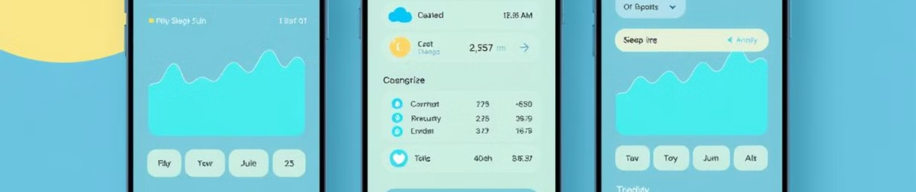
Description
The Sleep Tracker app is a mobile tool designed to help people get a better night's rest by giving them insights into their sleep patterns. Built with Android Jetpack Compose, the app provides an easy way to track sleep duration, rate sleep quality, and see an analysis of past sleep sessions, all in one place.
Here’s how it works: when users are ready to go to bed, they start a timer that keeps running until they wake up. This feature runs quietly in the background so users don’t have to worry about interruptions. In the morning, they can rate how well they slept, which helps the app build a profile of their sleep quality over time. By analyzing this data, the Sleep Tracker app provides personalized insights, showing trends in sleep duration and quality that users can use to identify any patterns or habits affecting their rest.
The app is designed to be simple and intuitive, making it easy to set up and use. With Jetpack Compose powering the interface, it’s modern, responsive, and looks great on any screen. Behind the scenes, features like ViewModel and Repository layers keep the app running smoothly and handling data reliably, even in the background. For anyone looking to better understand their sleep and develop healthier habits, the Sleep Tracker app offers a practical and accessible solution.

Slide 5

CODE (ACTIVITY MAIN)
package com.example.projectone
import android.content.Context
import android.content.Intent
import android.icu.text.SimpleDateFormat
import android.os.Bundle
import androidx.activity.ComponentActivity
import androidx.activity.compose.setContent
import androidx.compose.foundation.Image
import androidx.compose.foundation.layout.*
import androidx.compose.material.Button
import androidx.compose.material.MaterialTheme
import androidx.compose.material.Surface
import androidx.compose.material.Text
import androidx.compose.runtime.*
import androidx.compose.ui.Alignment
import androidx.compose.ui.Modifier
import androidx.compose.ui.draw.alpha
import androidx.compose.ui.layout.ContentScale
import androidx.compose.ui.res.painterResource

Slide 6
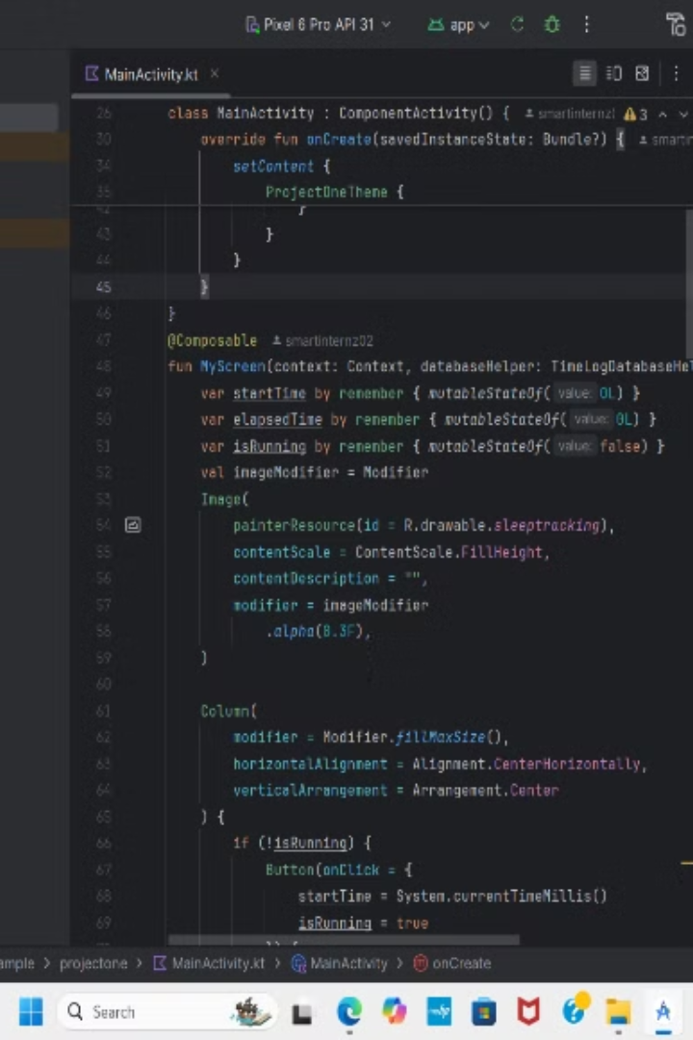
import androidx.compose.ui.unit.dp
import androidx.core.content.ContextCompat
import com.example.projectone.ui.theme.ProjectOneTheme
import java.util.*
class MainActivity : ComponentActivity() {
private lateinit var databaseHelper: TimeLogDatabaseHelper
override fun onCreate(savedInstanceState: Bundle?) {
super.onCreate(savedInstanceState)
databaseHelper = TimeLogDatabaseHelper(this)
databaseHelper.deleteAllData()
setContent {
ProjectOneTheme {
Surface(
modifier = Modifier.fillMaxSize(),
color = MaterialTheme.colors.background
) {
MyScreen(this,databaseHelper)
} } }}
@Composable
fun MyScreen(context: Context, databaseHelper: TimeLogDatabaseHelper) {
var startTime by remember { mutableStateOf(0L) }
var elapsedTime by remember { mutableStateOf(0L) }

Slide 7
var isRunning by remember { mutableStateOf(false) }
val imageModifier = Modifier
Image(
painterResource(id = R.drawable.sleeptracking),
contentScale = ContentScale.FillHeight,
contentDescription = "",
modifier = imageModifier
.alpha(0.3F),
)
Column(
modifier = Modifier.fillMaxSize(),
horizontalAlignment = Alignment.CenterHorizontally,
verticalArrangement = Arrangement.Center
) {
if (!isRunning) {
Button(onClick = {
startTime = System.currentTimeMillis()
isRunning = true
}) {
Text("Start")

Slide 8
//databaseHelper.addTimeLog(startTime)
}
} else {
Button(onClick = {
elapsedTime = System.currentTimeMillis()
isRunning = false
}) {
Text("Stop")
databaseHelper.addTimeLog(elapsedTime,startTime)
}
}
Spacer(modifier = Modifier.height(16.dp))
Text(text = "Elapsed Time: ${formatTime(elapsedTime - startTime)}")
Spacer(modifier = Modifier.height(16.dp))
Button(onClick = { context.startActivity(
Intent(
context,
TrackActivity::class.java
)
) }) {

Slide 9
Text(text = "Track Sleep")
}
}
}
private fun startTrackActivity(context: Context) {
val intent = Intent(context, TrackActivity::class.java)
ContextCompat.startActivity(context, intent, null)
}
fun getCurrentDateTime(): String {
val dateFormat = SimpleDateFormat("yyyy-MM-dd HH:mm:ss", Locale.getDefault())
val currentTime = System.currentTimeMillis()
return dateFormat.format(Date(currentTime))
}
fun formatTime(timeInMillis: Long): String {
val hours = (timeInMillis / (1000 * 60 * 60)) % 24
val minutes = (timeInMillis / (1000 * 60)) % 60
val seconds = (timeInMillis / 1000) % 60
return String.format("%02d:%02d:%02d", hours, minutes, seconds)

Slide 10
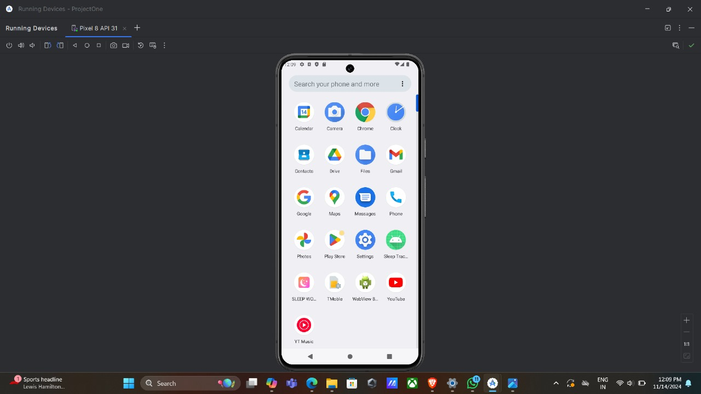
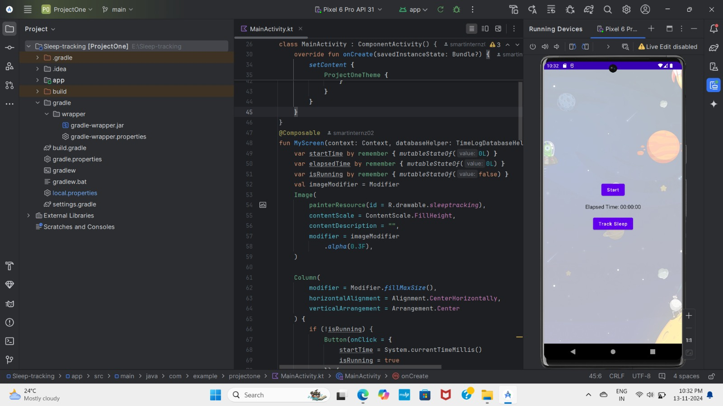
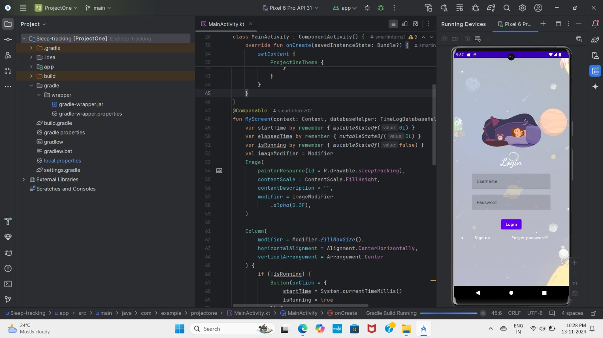
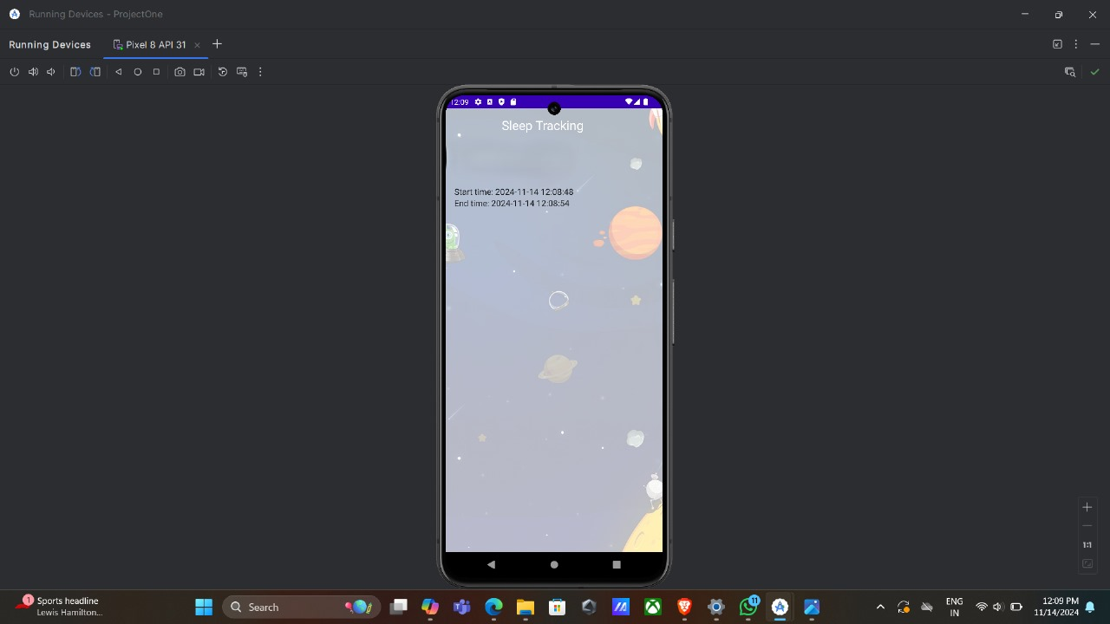
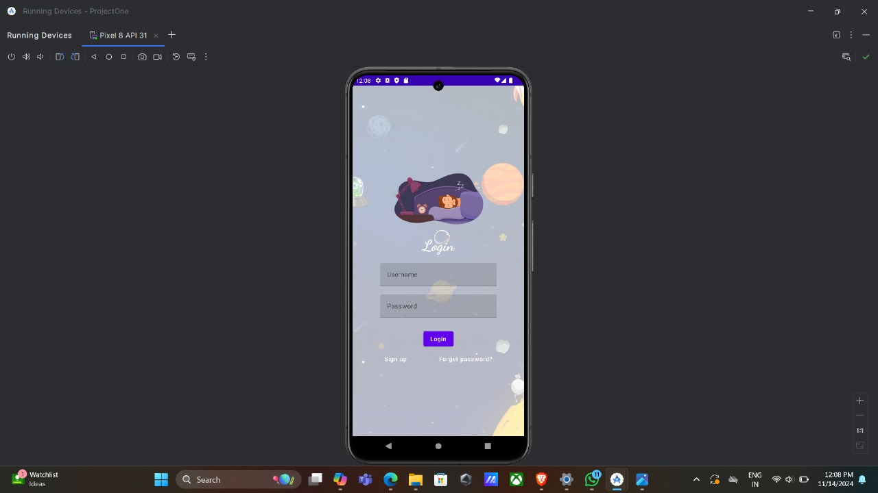
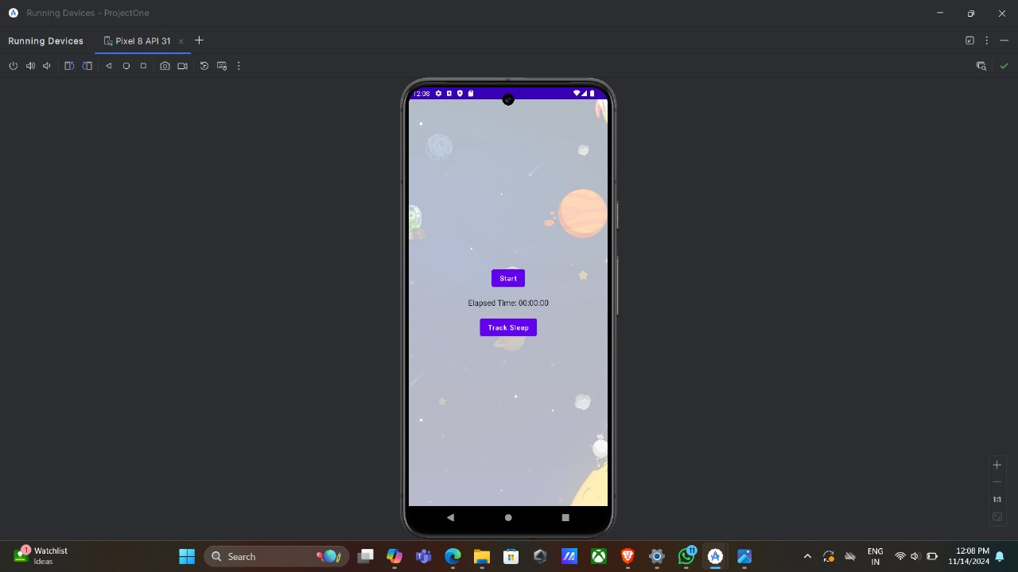
Output

Slide 11




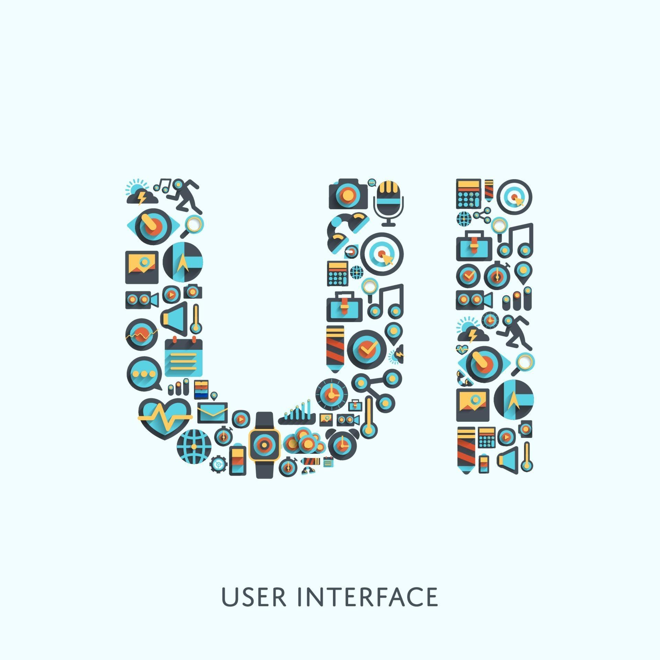
Functionalities
Sleep Tracking
Users can start and stop a sleep timer, which runs seamlessly in the background for uninterrupted tracking.
Sleep Quality Rating
Upon stopping the timer, users can rate their sleep quality based on their experience, providing valuable data for analysis.
Sleep Analysis
The app analyzes sleep data and presents insights into sleep duration, quality, and patterns, helping users understand their sleep better.
User Interface
Built using Android Jetpack Compose, the app features an intuitive and responsive design that enhances user experience.

Slide 12
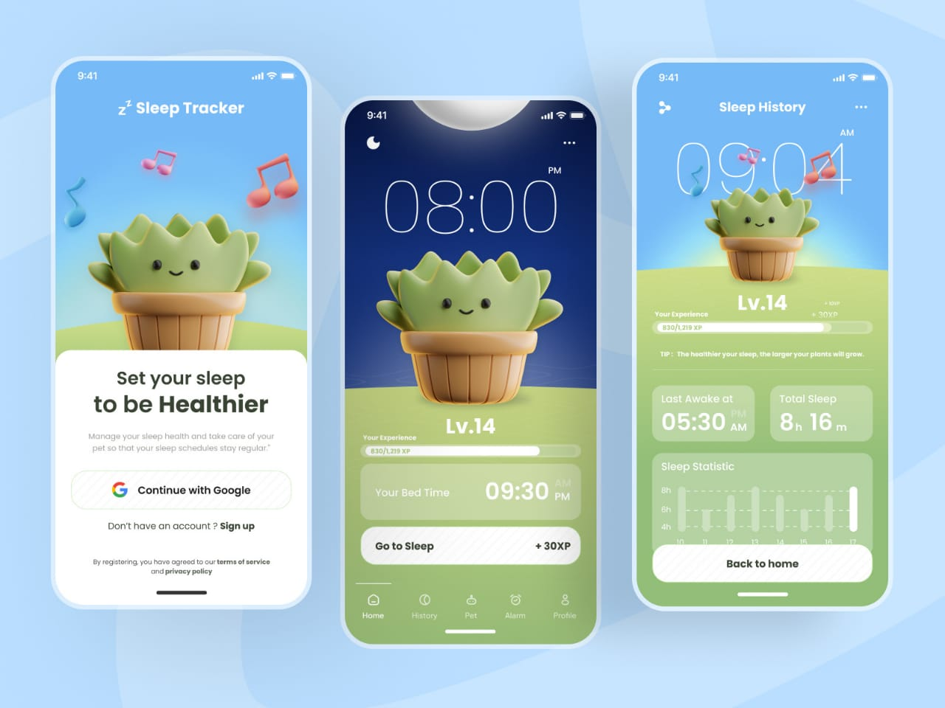
Reference
Demo video link:
https://drive.google.com/file/d/1Xr-3dDiPT0R57rTxLGiEhNLPz-I9HtX5/view?usp=drive_link
1. Android Documentation for Jetpack Compose:
https://developer.android.com/jetpack/compose
2. WorkManager for Background Tasks:
https://developer.android.com/topic/libraries/architecture/workmanager
3. Room Database for Data Storage:
https://developer.android.com/training/data-storage/room
4.Android Sleep Tracking and Sleep Science:
https://www.sleepfoundation.org/
https://pubmed.ncbi.nlm.nih.gov/32520907/
5.Android Permissions and Background Tasks:
https://developer.android.com/guide/topics/permissions/overviw

Slide 13

Conclusion
The "Sleep Tracker" app uses Jetpack Compose and WorkManager to provide a seamless and reliable experience for tracking sleep. By addressing background task management, accurate data storage with Room Database, and real-time updates through View Model and LiveData, the app ensures precise monitoring of sleep duration and quality over time. With a clean interface and robust functionality, it highlights the importance of sleep for health, enabling users to make informed choices to improve their sleep habits. Despite Android’s background limitations and new UI frameworks, this project demonstrates the potential of modern Android tools for building user-friendly, powerful applications.

